Slide 1


Green Pace
Security Policy Presentation
Developer: Christopher Holmes

Slide 2

OVERVIEW: DEFENSE IN DEPTH
Protect all points!

Slide 3
THREATS MATRIX
Likely An attack that will occur. | Priority Dangerous and we will fix.
Low priority Important, but not gravely. | Unlikely We can fix if we have time.

Slide 4
10 PRINCIPLES
Validate Input Data
Heed Compiler Warnings
Architect and Design for Security Policies
Keep It Simple
Default Deny
Adhere to the Principle of Least Privilege
Sanitize Data Sent to Other Systems
Practice Defense in Depth
Use Effective Quality Assurance Techniques
Adopt a Secure Coding Standard

Slide 5
CODING STANDARDS
Priority 1: Do not access freed memory
Priority 2: Do not attempt to create a std::string from a null pointer.
Priority 3: Do not read uninitialized memory.
Priority 4: Do not use pointer-to-member operators to access nonexistent members.
Priority 5: Do not alternately input and output from a file stream without an intervening positioning call.
Priority 6: Use valid references, pointers, and iterators to reference elements of a container.
Priority 7: Do not cast to an out-of-range enumeration value.
Priority 8: Close files when they are no longer needed
Priority 9: Handle all exceptions
Priority 10: Never qualify a reference type with const or volatile.

Slide 6
ENCRYPTION POLICIES
Encrypt at rest all sensitive data! Encryption in rest means encrypting the critical data that is stored. This usually is in the form of passwords to assure that if anyone gains access to the passwords that are stored on the servers/hard drives, that they will be unreadable because of the encryption.
Encrypt in flight! Encryption in flight, this means encrypting the data from server to user or user to user. This is to stop a man in the middle attack and assure that all data is protected to it reaches its destination.
Encrypt in use! Encryption in use is to assure that all data is encrypted while used. This is to assure that sensitive data is never left unsecured. Having the data encrypted at every step of the way makes sure that data breach will mean that sensitive data was always encrypted and secured.

Slide 7
TRIPLE-A POLICIES
Authenticate- Authentication is a way to authenticate the user. This is to assure that only authorized users gain access to systems. Every user should have unique credentials. Any changes to the database should be authorized also.
Authorization- Authorization means providing roles for every person. Every role should have minimum authorization. A user should only be able to do what they are required to do while accessing the systems. There should be a user level of access. New users should start out with the lowest security rating, only granting access to required permissions.
Accounting- Accounting is monitoring the system. Making sure that nothing strange is happening while someone is using a system. That a user does not receive or download more data than should be downloaded by the user. Any file accessed by a user should accounted for.

Slide 8
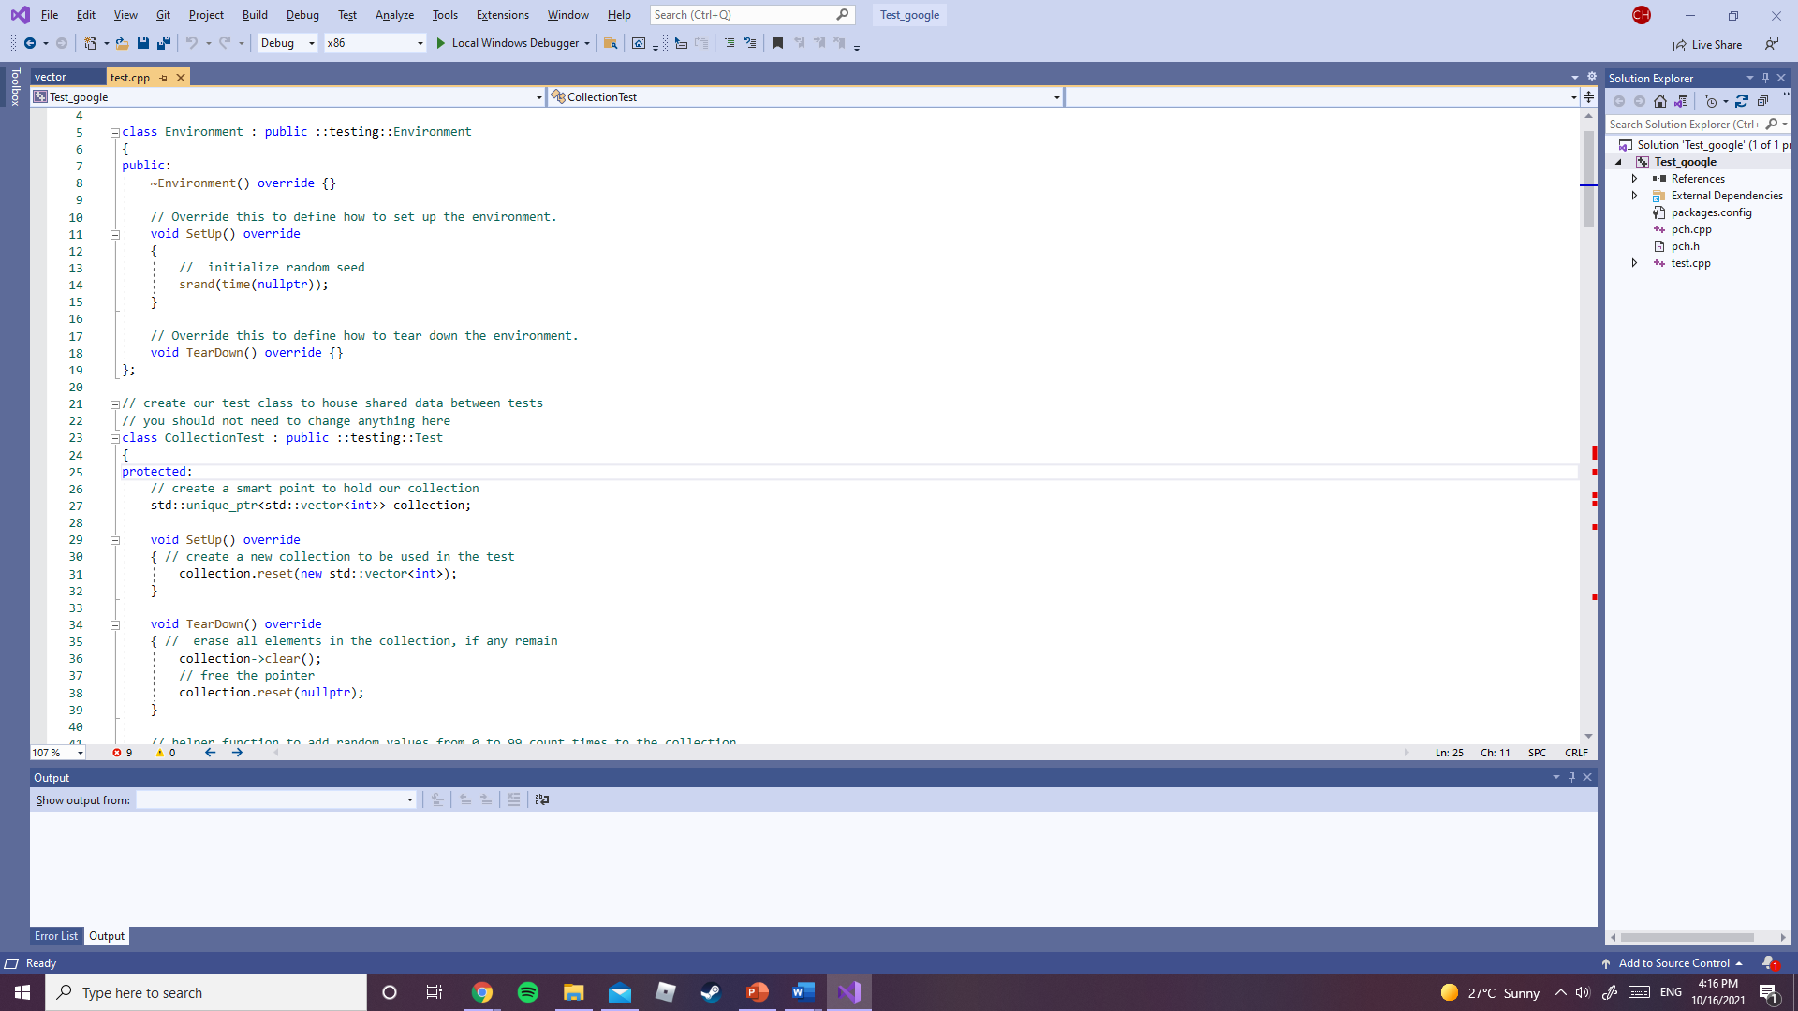
Unit Testing

Slide 9

AUTOMATION SUMMARY

Slide 10
TOOLS
The DevSecOps pipeline is to find security risk earlier. First, there should be models of threats. Then we will scan the code while developing using tools. We analyze the threats. Then we will remediate the vulnerabilities. Then monitor for feature vulnerabilities in the software.
There are various external tools that we can use to discover vulnerabilities. These tools are used at every step of the process. For example, google unit test can be used.
To test while coding and assure that the first developer fixes the code.

Slide 11
RISKS AND BENEFITS
The risk of not starting now is these vulnerabilities are open.
We should start now, because the benefit of developing secure code is that it eliminates remediation cost.
The risk of starting now is that the process of developing could take longer.
The benefit is that the code will be secure, and this will provide safe practices environment for the company and its users.
This strategy will help our company advance to be one of the most secure.

Slide 12
RECOMMENDATIONS
This policy is the basis for security, implementation will depend on the team and the chief information security officer.
Training should be developed to all new employees on how to develop secure code.
Routine checks to assure that the policy is being followed.

Slide 13
CONCLUSIONS
Defense in depth should be practiced.
Assure to eliminate security risk while coding to eliminate remediation cost.
Test at every step of the process.
Use external tools to test vulnerabilities in the software.
Assume that security will fail and prevent damage.

Slide 14
REFERENCES
Foster, S. (2021, January 22). DevSecOps pipeline overview: Devsecops simplified. Perforce Software. Retrieved October 16, 2021, from https://www.perforce.com/blog/kw/devsecops-pipeline-overview.
SEI CERT C++ Coding Standard. SEI CERT C++ Coding Standard - SEI CERT C++ Coding Standard - Confluence. (n.d.). Retrieved October 16, 2021, from https://wiki.sei.cmu.edu/confluence/pages/viewpage.action?pageId=88046682.

